Slide 1
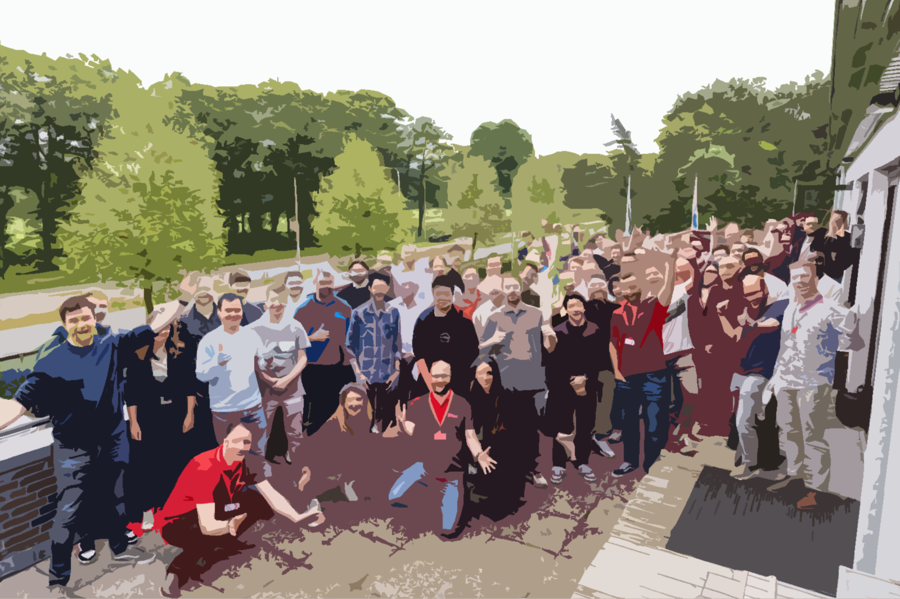


Rethinking Modularity: Structural, Runtime, and Functional Patterns for Scalable Systems
2025
Auke Haanstra
Zaal 3 | 14:00-15:00

Slide 2


Who am I?
Auke Haanstra, consultant expert level at Pancompany
Expertise: TDD, Architecture
9 years of experience in Java development
More than 100 IT consultants

Slide 3
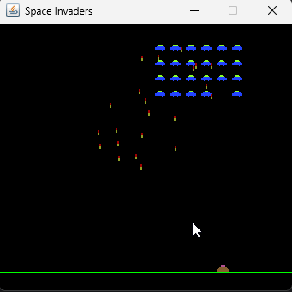
Contents
Introduction: Modularity and Coupling
Hexagonal Architecture
Complementary Patterns
Java Modules
Spring Modulith
Multi-container setups with Spring
Event Sourcing
Conclusion

Slide 4
Introduction
Modularity and Coupling

Slide 5
Coupling, Cohesion and Modularity
Coupling is the degree of interdependence between parts of a system.
Cohesion is the degree to which the elements within a single part of a system belong together.
Modularity: The organization of a system into distinct, self-contained components (modules)
These hide their internal workings
Communicate through stable and well-defined interfaces
Enabling independent understanding, testing, and modification.
A modular application is an application with low coupling and high cohesion, where modules communicate via well-defined interfaces
Modularization is very important when we want to be able to grow and scale our application

Slide 6
2. Hexagonal Architecture

Slide 7
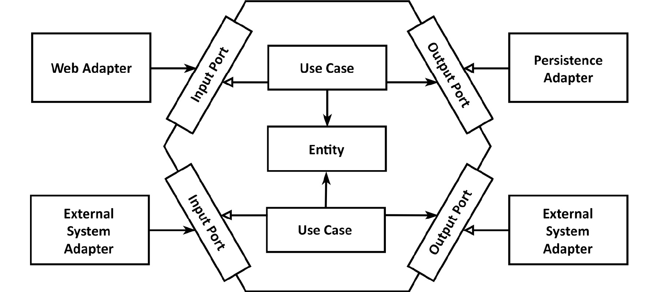
Hexagonal architecture
In its simplest form Hexagonal Architecture is three-tier architecture + best practices!

Slide 8
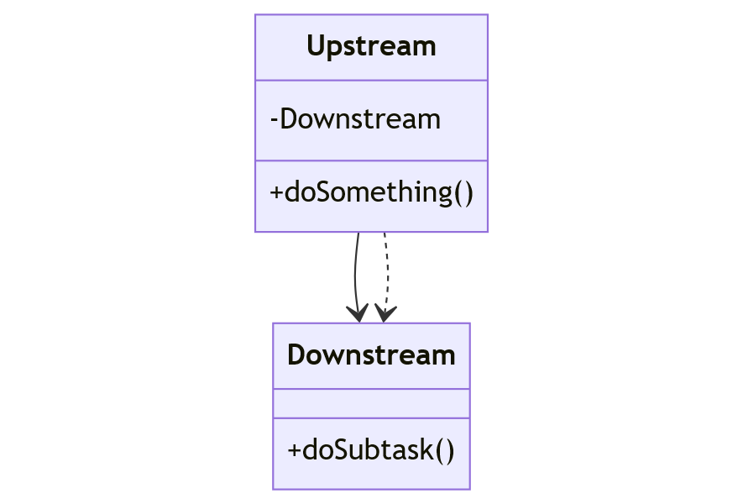
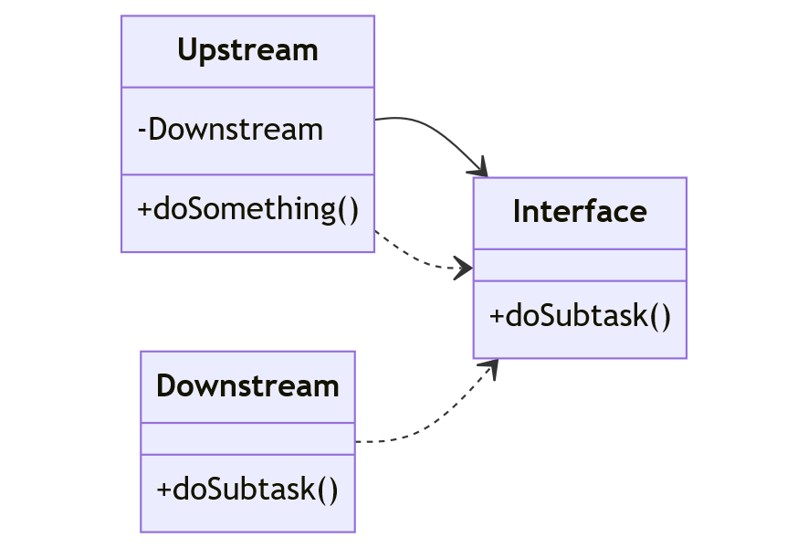
Dependency Inversion
Regular
Dependency Inversion
Upstream

Slide 9
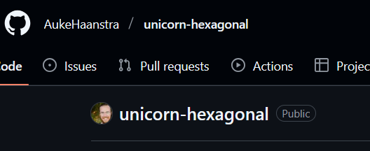
Example of application structure

Slide 10

Hexagonal architecture is an enabler
A very simple “ports-and-adapters” pattern
By separating domain from infrastructure, we can:
Practice TDD and Refactoring
Practice Object-Oriented Design on our domain entities
Practice Domain Driven Development (DDD)
Modularize our application along architectural boundaries
Hexagonal architecture is therefore an enabler for good software development practices.
Amazon Web Services recommends this architecture regardless of project complexity*
But.. The modularity obtained is very structural and technical in nature.
*AWS Prescriptive Guidance: Building hexagonal architectures on AWS, 2022

Slide 11
3.1 Java Modules

Slide 12

Advantages of Java modules
Stronger encapsulation than before, both compile-time and run-time
Reusability
Insight into dependencies
But… Java modules are not very popular
Nobody seems to use them in applications
Support lacks in popular frameworks (Spring)
But you can still benefit from Java Modules at compile time
Then you start your application from a non-modular main (Maven) module (on the classpath)

Slide 13
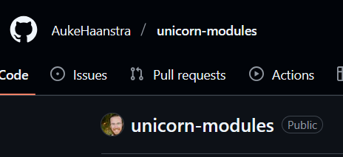
Example of application structure

Slide 14
3.2 Spring Modulith

Slide 15
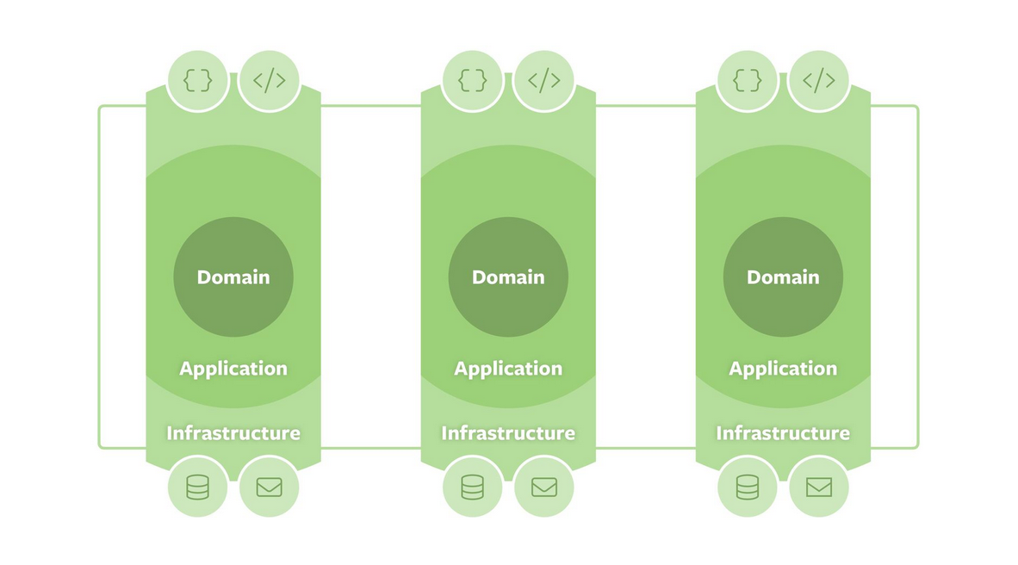
What does Spring Modulith do?
Supports vertical slicing of your application
Can be DDD Bounded Contexts
Or even smaller functional slices as with Event Sourcing
Decoupling through messaging via the Spring Event Bus
Boundaries are enforced with ArchUnit only at runtime, in contrast to java modules
Gradual migration from OPEN to CLOSED modules possible
Facilitates Event Driven Architectures (EDA)
Facilitaties migration to microservices (via @Externalized on event listeners)
Architecture agnostic
Meant to make it easy to split off a module as a microservices

Slide 16
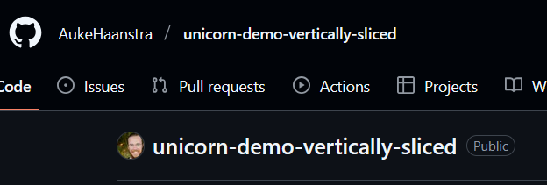
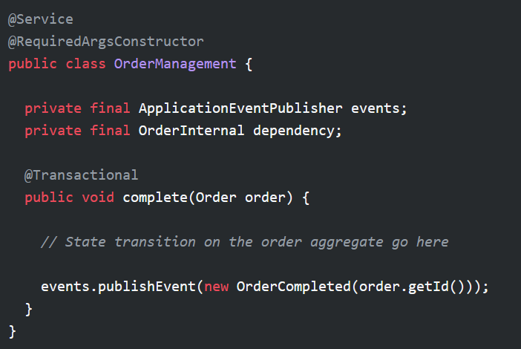
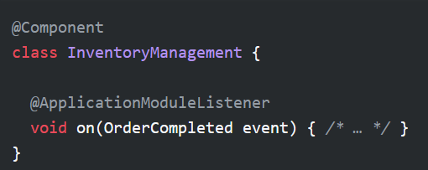
Spring Modulith example

Slide 17
3.3 Multi-container setups with Spring

Slide 18
Multiple Spring Application Contexts
You can manually instantiate a Spring ApplicationContext
Either use an AnnotationConfigApplicationContext
or an AnnotationConfigServletWebServerApplicationContext (web app)
Set a parent context (context hierarchy), or keep a context isolated (more modular)
Expose beans, with getBean(), or register beans, with registerBean(), for inter-module dependencies
You can propagate profiles (or not)
You can run both contexts in separate applications for testing, or run them together, since they are decoupled
In this way you can completely isolate two modules at run-time
And split them into distinct microservices when needed

Slide 19
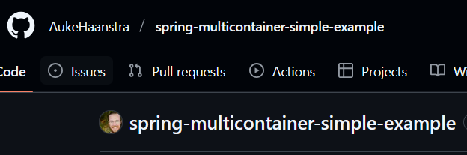
Example

Slide 20
4. Event Sourcing

Slide 21
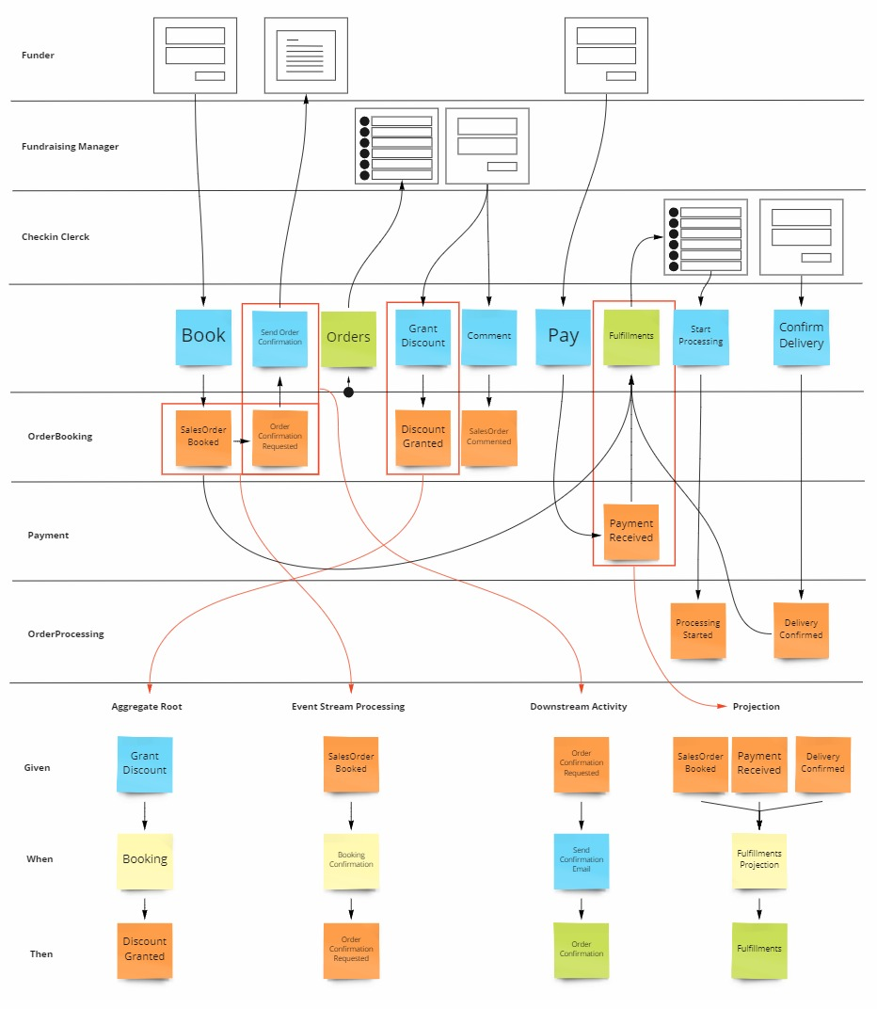
Event Modeling
Bron: https://www.goeleven.com/blog/event-modeling/
A method to describe a system
Resembles Event Storming (DDD)
A collaboration of Developers and Business Experts
Focuses on the flow of information
Readable, like a story, on a timeline
Given-When-Then specs for business rules
→ Saves development time
→ Parallel development through vertical slicing

Slide 22
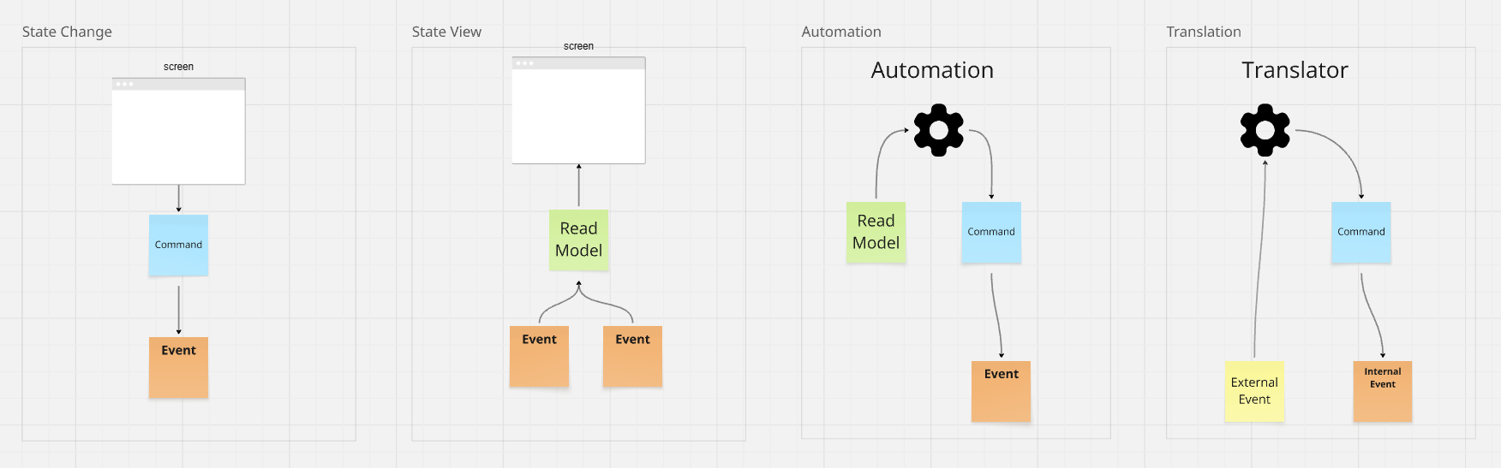
Event Modeling – 4 Patterns that result in vertical slices

Slide 23
Event Sourcing vs CRUD
CRUD: update & delete old information
In an Event Sourced system
every piece of information
every state
is captured by events
Never altered or deleted.

Slide 24
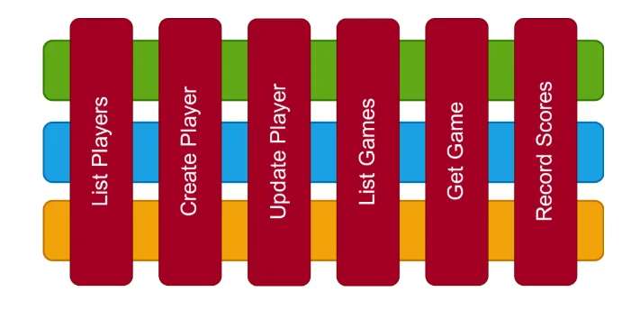
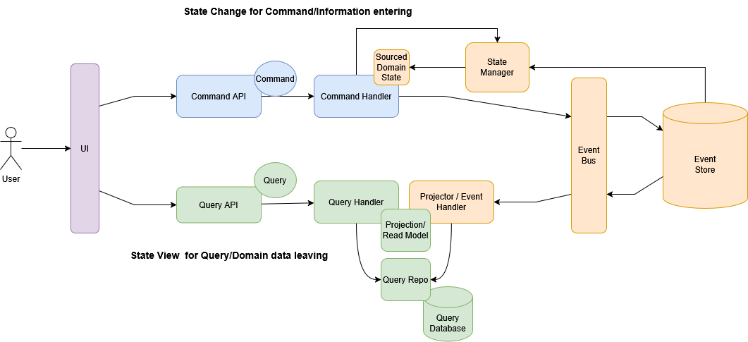
Advantages of event-sourcing
A full history of past events
Full audit trail
Time travel & replay
Debugging & forensics
Business insight
2. Modularity through vertical slicing and messaging
Evolvable read models through CQRS
Evolvable write models, when using Dynamic Consistency Boundaries (DCB)

Slide 25

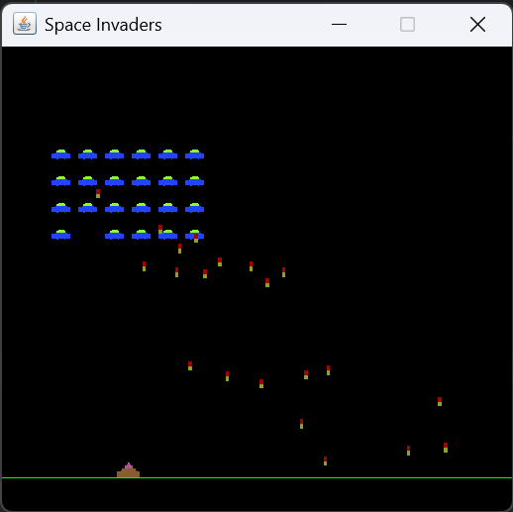
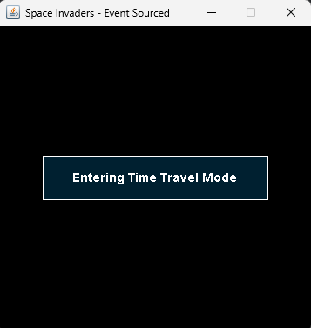
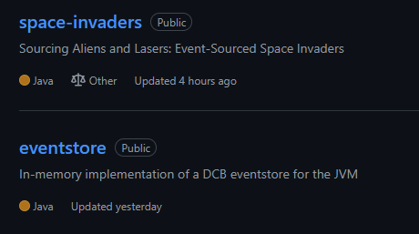
Example: Space Invaders A fun introduction to Event Sourcing
Let’s play ! ☺
1978 Tomohiro Nishikado
2019 Jan Bodnar
2025 By me ☺

Slide 26
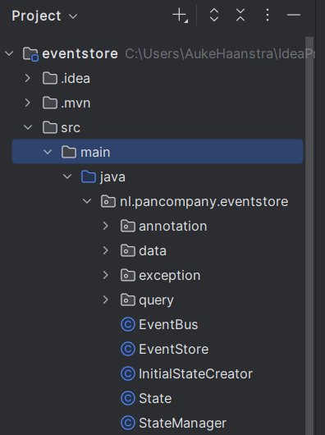
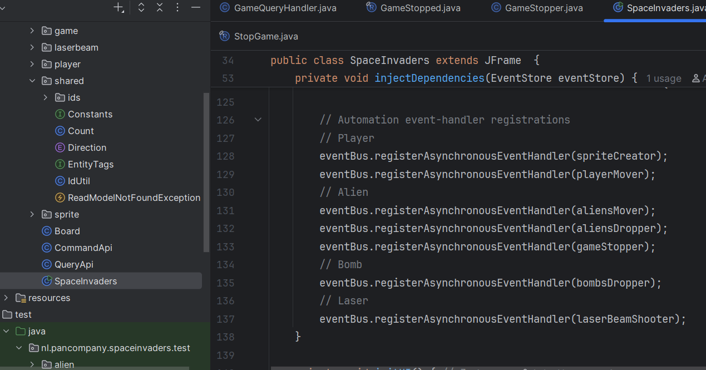
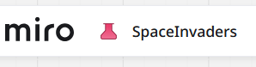
Game code overview

Slide 27
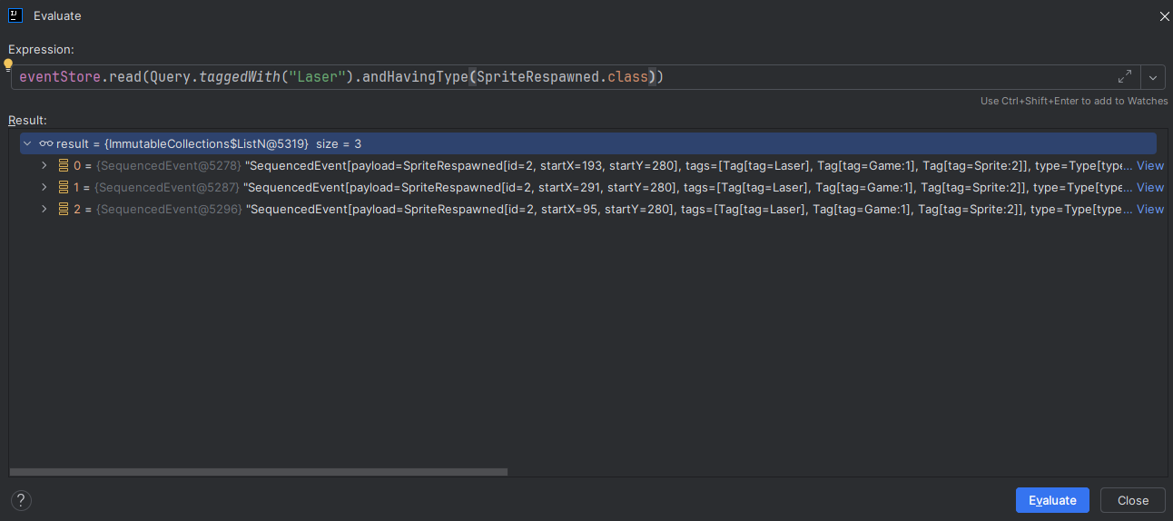
Debugging with Space Invaders

Slide 28
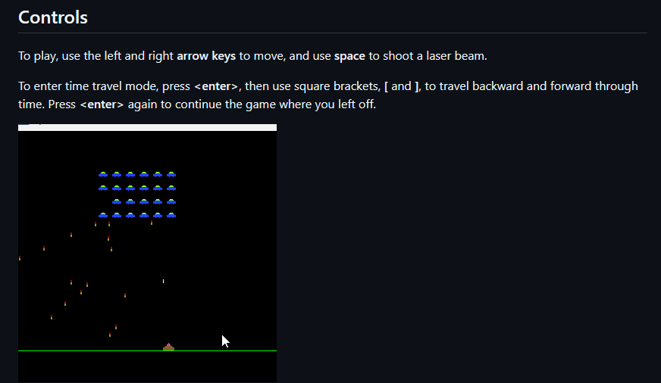
Example: Time Travel with Space Invaders

Slide 29
5. Conclusion

Slide 30
A Philosophical Conclusion
2nd Law of Thermodynamics: Entropy always increases in a closed system
To bring order, we always need to invest time and energy
Without organization, we are not able to do our work properly
Nobody can work well in a mess
And in the end, the functional quality of the system will suffer
Also the growth of the application and the company may be impeded
For each system, we have to consider:
How much organization do we actually need and want?
What would be the best type of organization/architecture for our system?
Can we invest the time and energy to attain that organization?
Examples of relevant questions:
- Are we expecting multiple microservices in the future?
- Can we exclude the possibility that we might need auditlogging?
- Are we sure we can delete old data?
- How flexible must the system be to changing requirements?

Slide 31
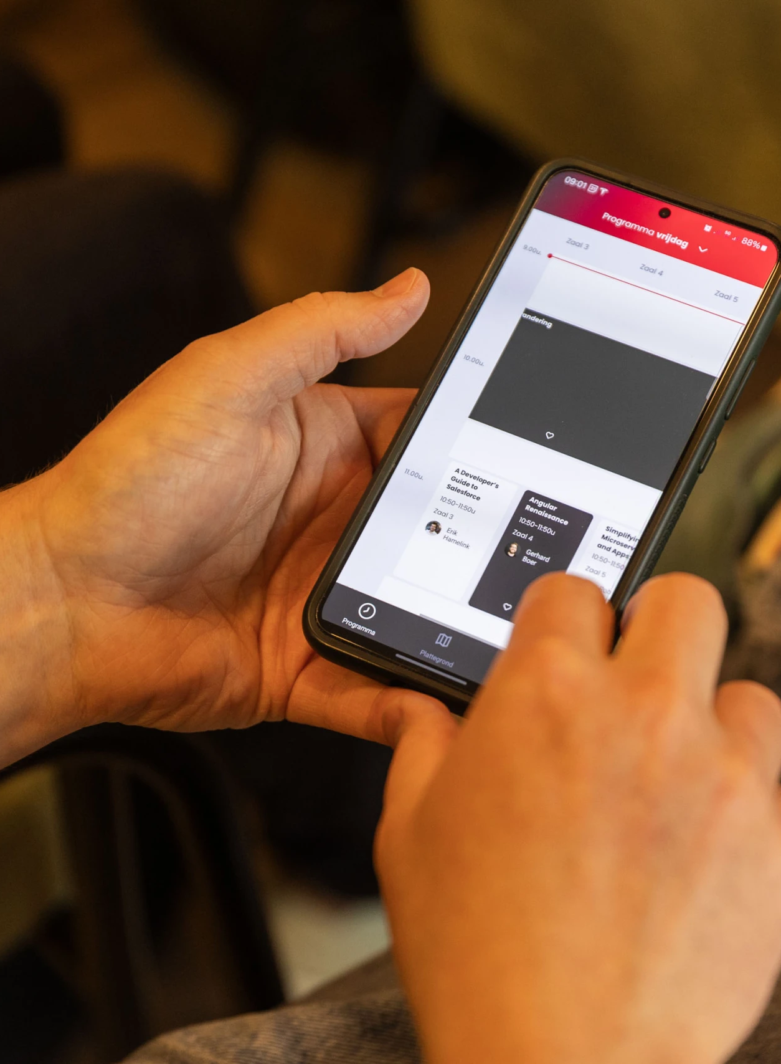


https://github.com/AukeHaanstra
Auke Haanstra
ahaanstra@pancompany.com
Beoordeel de sessie in de app!
2025

